Slide 1
Strategic Removal of Lockdowns in Pandemic

Slide 2

SIR Model
S : susceptible
I : infected
R : recovered / removed
$\frac{dS}{dt}=−\frac{βSI}{N}$
$\frac{dI}{dt}=\frac{βSI}{N}−γI$
$\frac{dR}{dt}=γI$

Slide 3
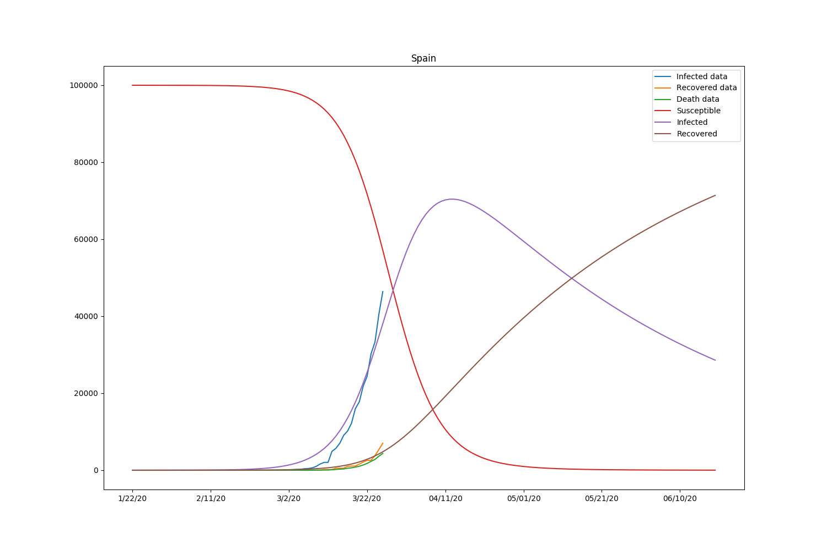
Traditional SIR Fitting

Slide 4
Flaws of Traditional SIR
Simplistic categories
Constant parameters
No travel or population change (reopen)

Slide 5
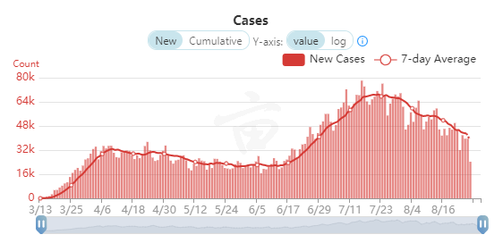
Difficulties in Fitting
Data reports fluctuate based on day of week

Slide 6
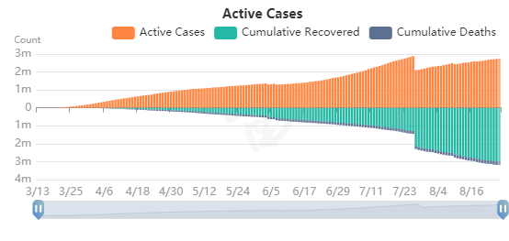
Difficulties in Fitting
Recovery data are poorly reported

Slide 7
Our Approach
Fit the cumulative cases
Use a dynamic β incorporating social distancing change
Add a hiding population group for reopening

Slide 8
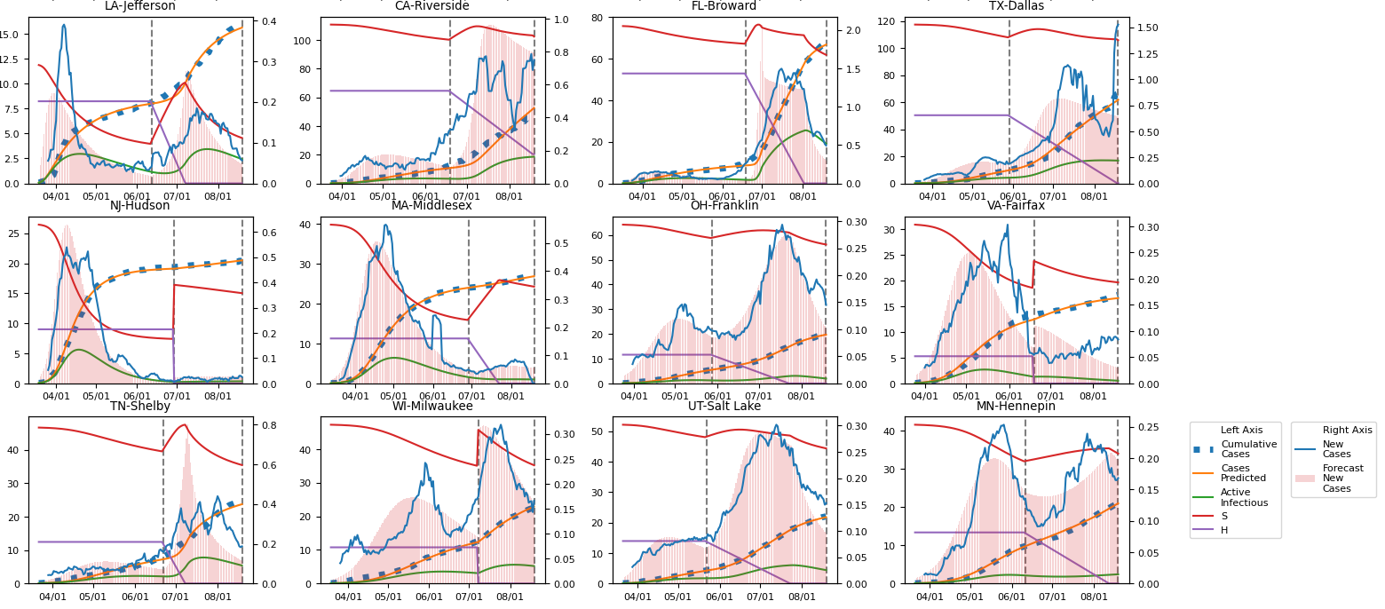

Slide 9
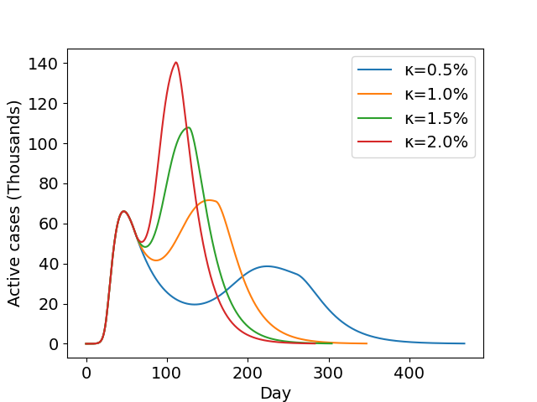
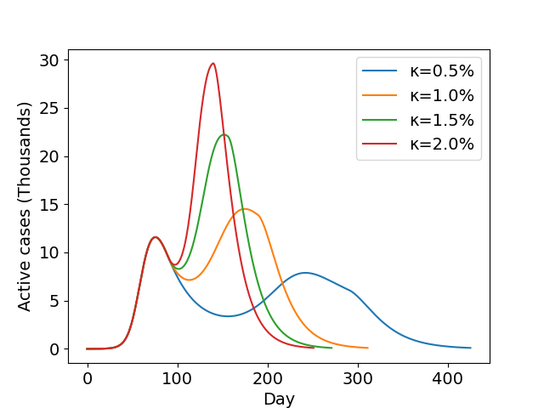
Policies of Reopening
Linear release : New York City and Chicago

Slide 10
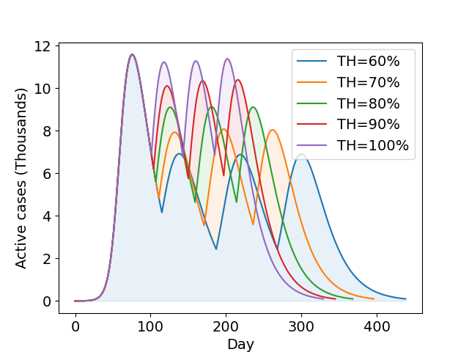
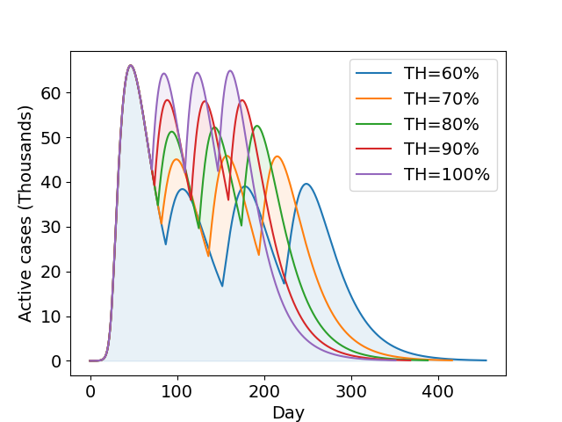
Policies of Reopening
3-phase release : New York City and Chicago

Slide 11
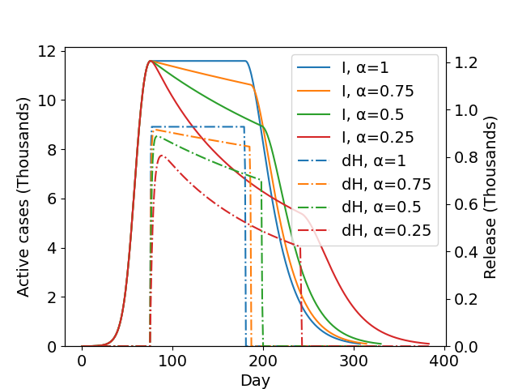
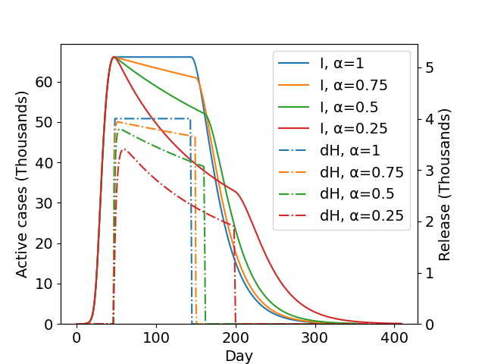
Policies of Reopening
Gradual release : New York City and Chicago

